Slide 2
HISTORY IN THE CLASSROOM
2008 Pennsylvania Abandoned Mine Reclamation & Coal Mining Heritage Conference
August 14, 2008

Slide 3
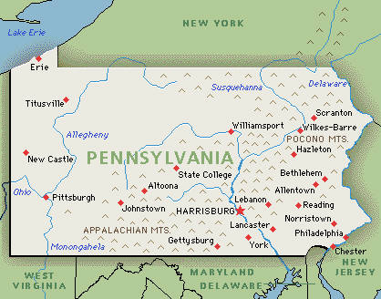

Slide 7
COURSE FOCUS
National Road Era
Coal and Coke Era

Slide 8

WHO ARE YOU ?
WHY ARE YOU HERE ?

Slide 9
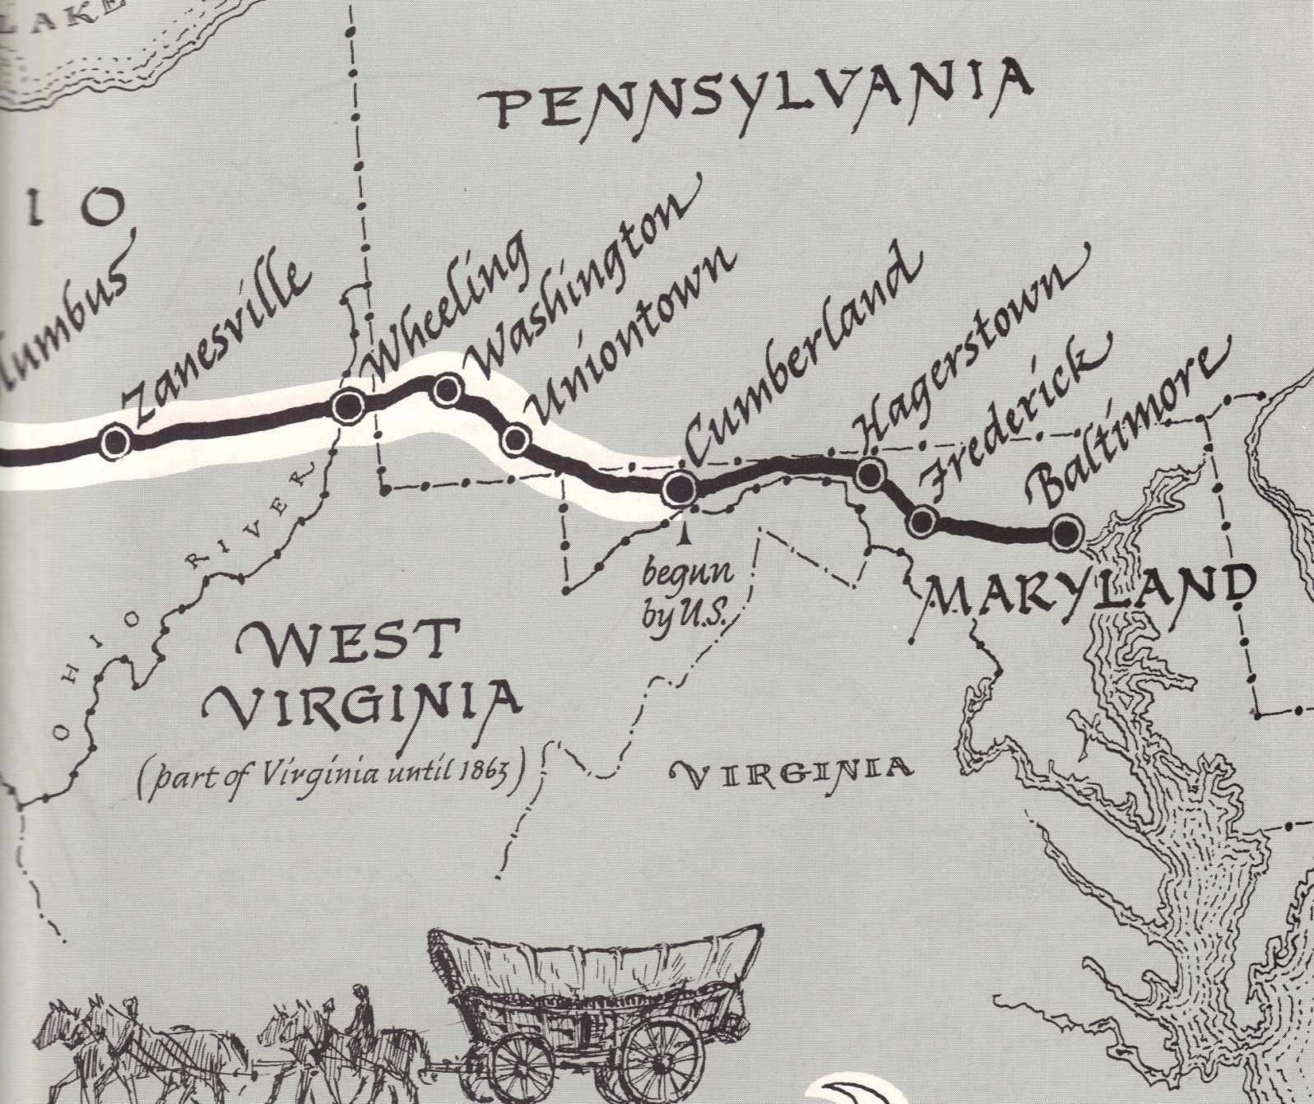
The National Road

Slide 10
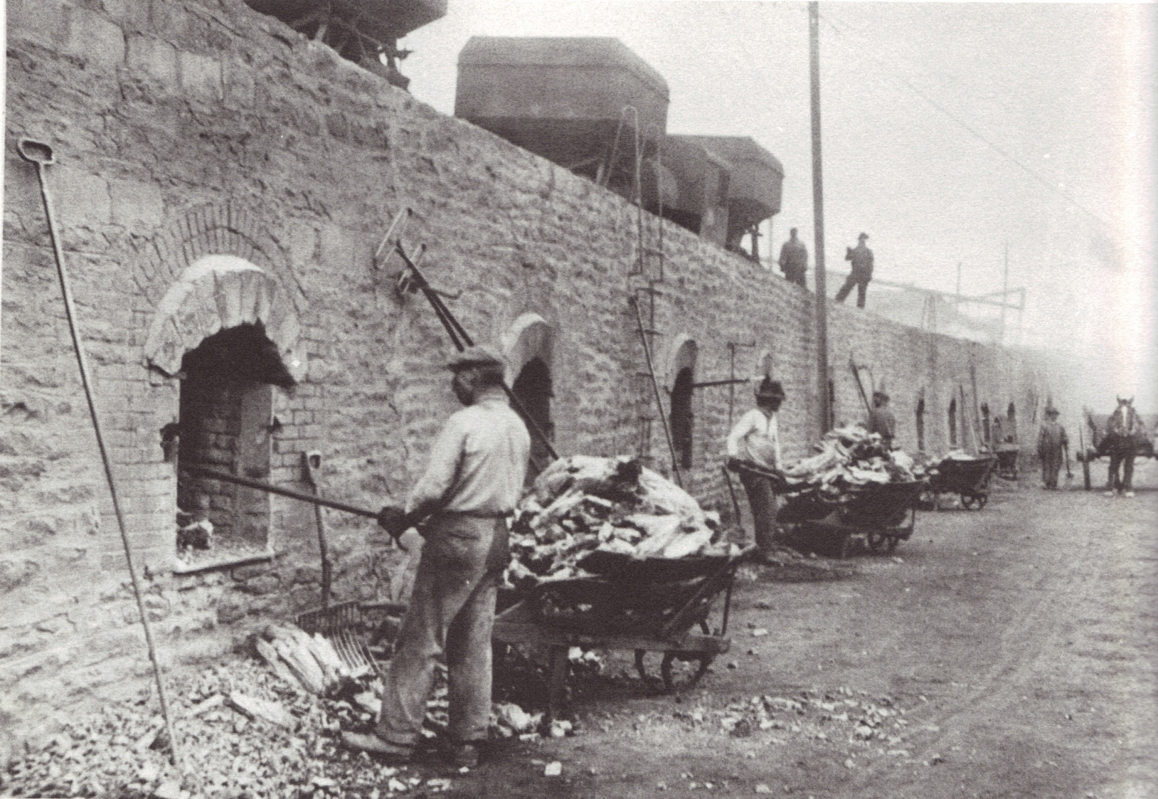
Coal and Coke

Slide 11
COAL PATCH VOCABULARY
Tipple
Outhouse
Honey Dipper
Red Dog
Scab
Larries
Pit Horse
Bubba
Company House/Store
UMWA
Mitchell Day
Black Lung
“Fire in the hole”
Frick hump

Slide 12
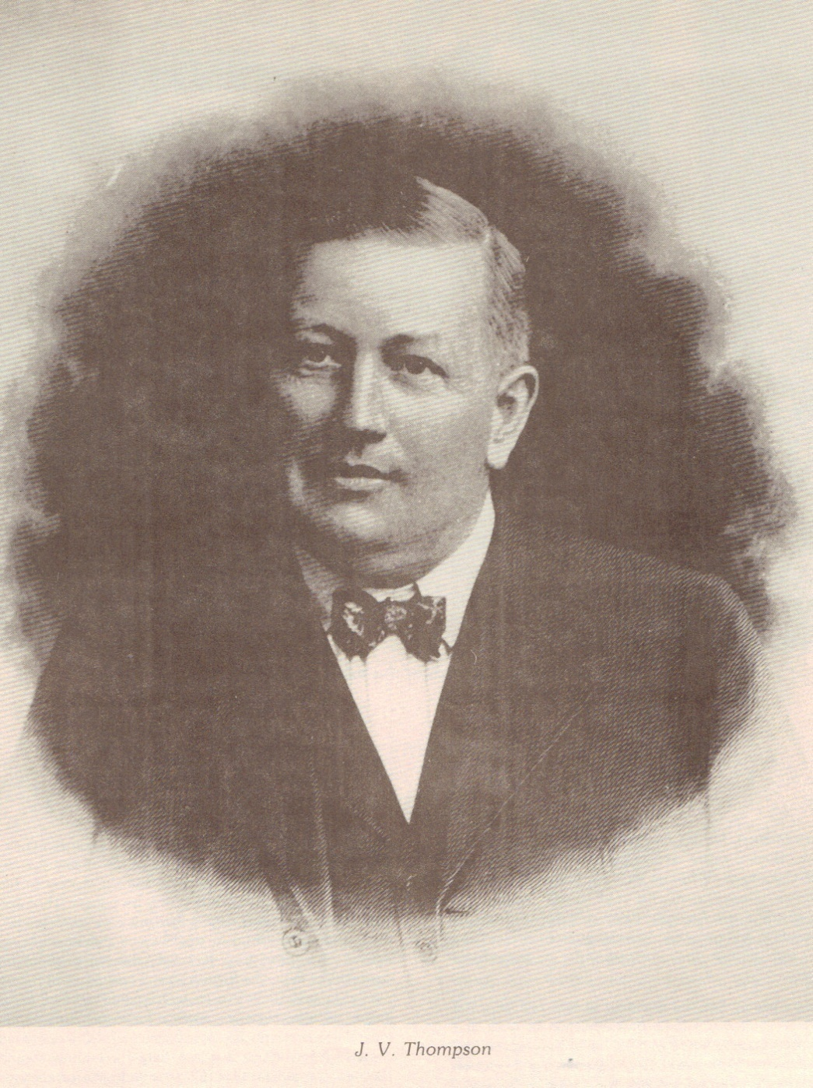

Slide 13


Slide 14
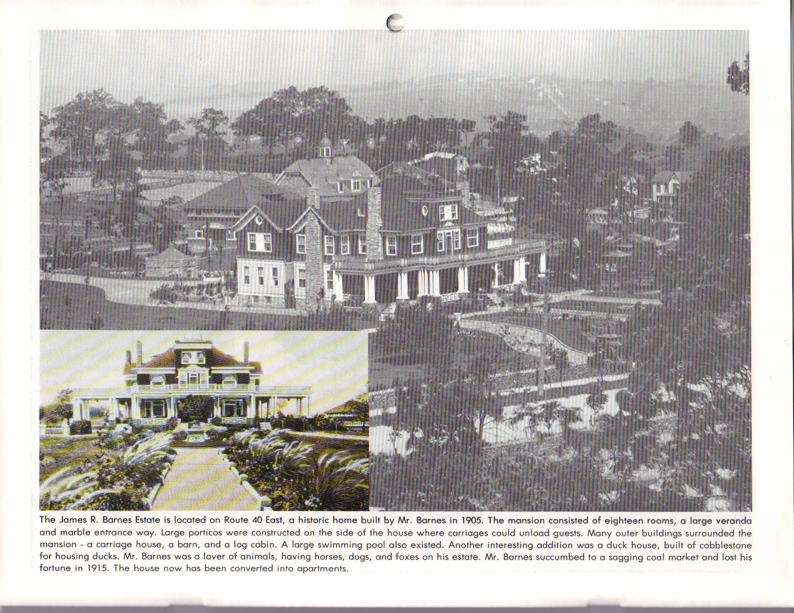

Slide 15
ASSIGNMENTS
Photographs
Interviews
Essays

Slide 16
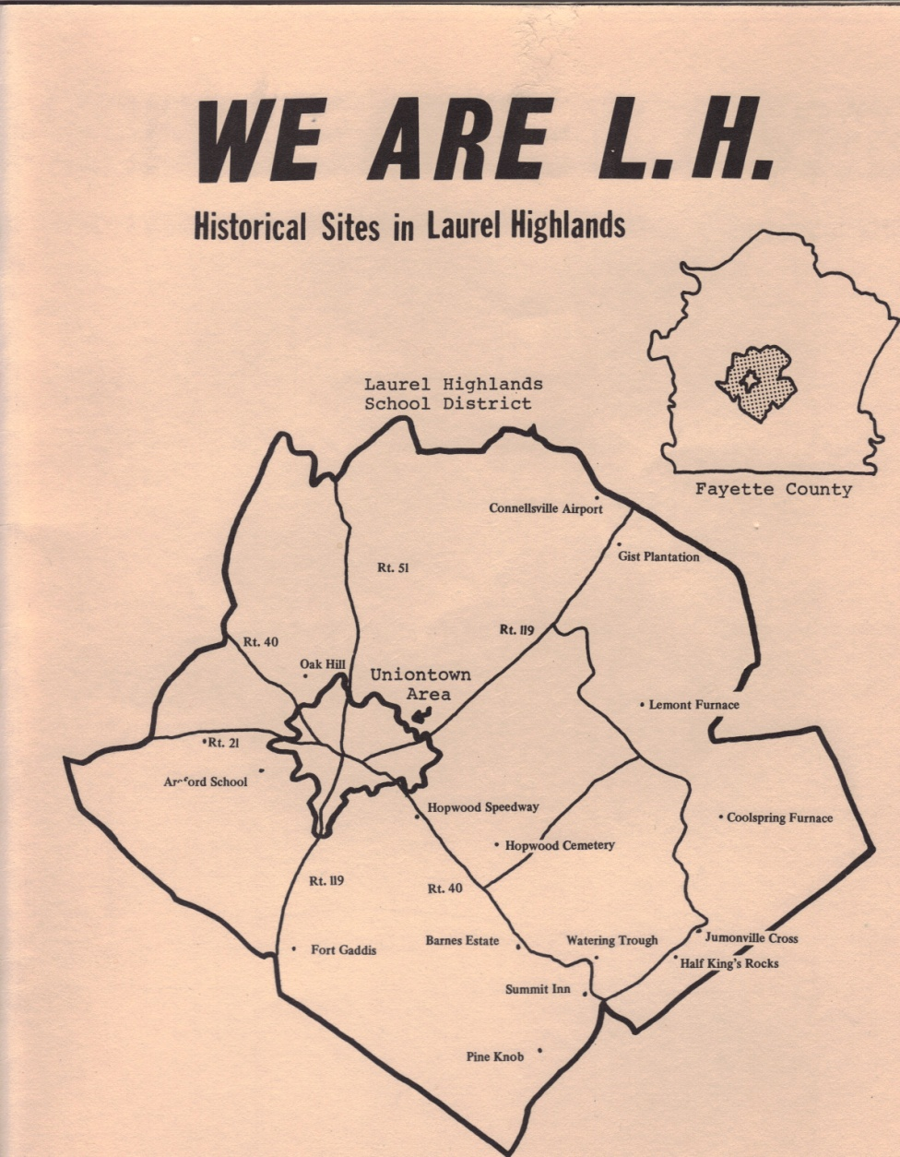

Slide 17


Slide 18
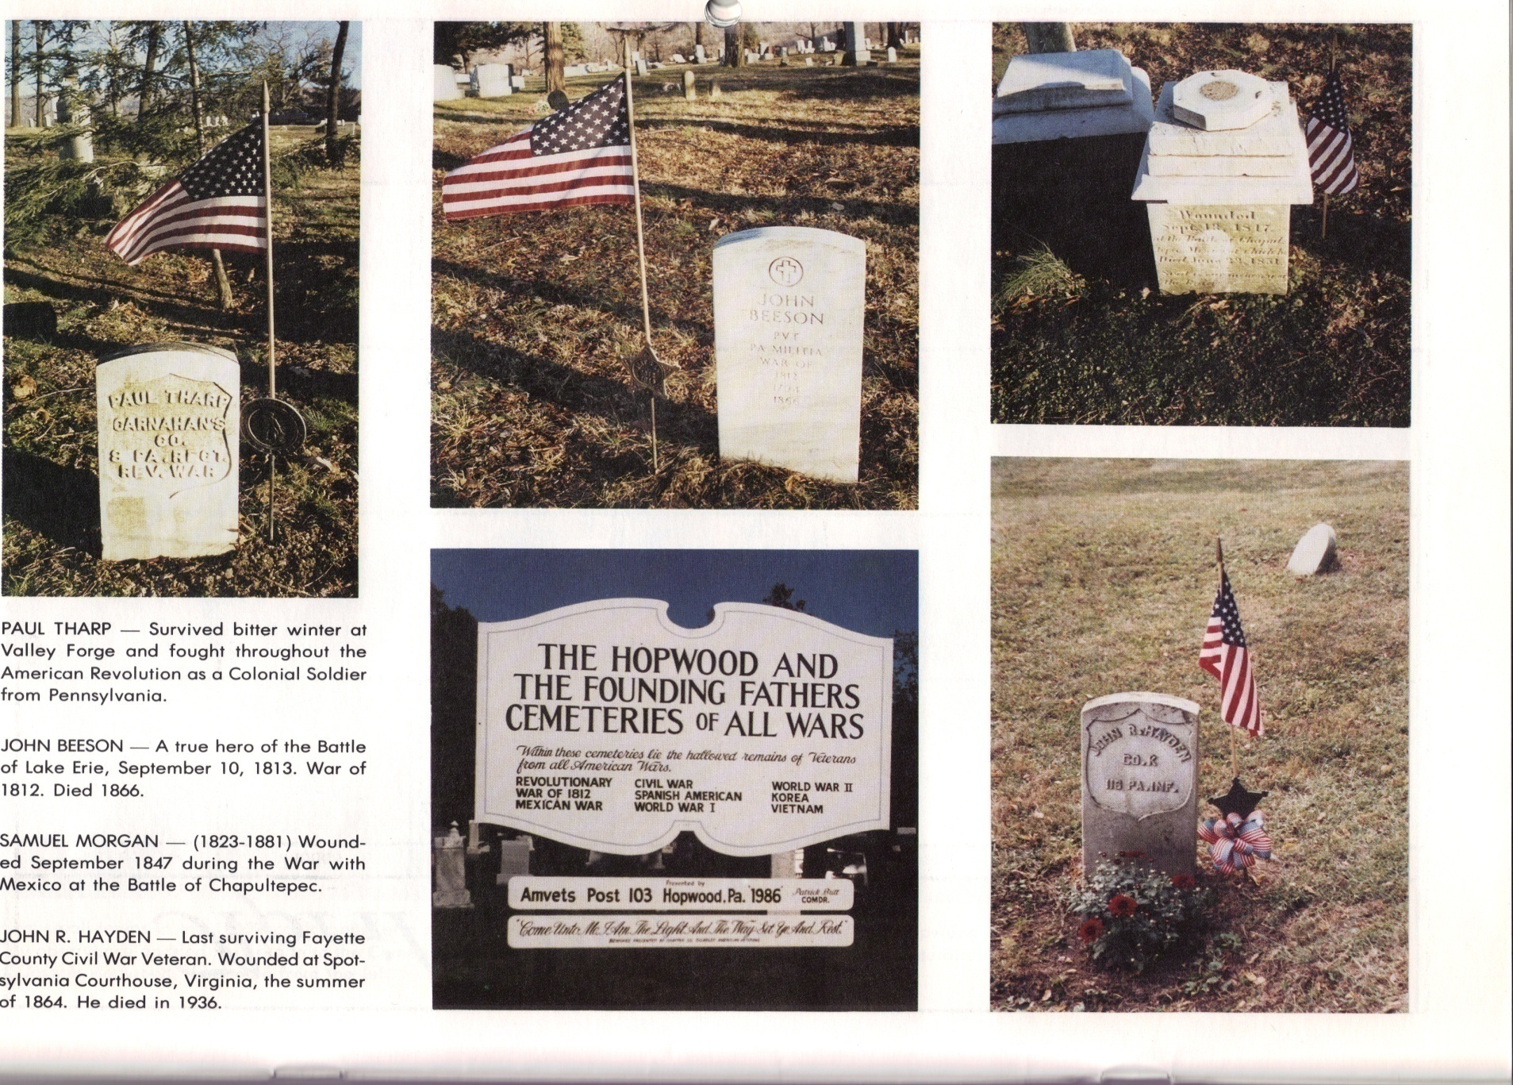

Slide 19
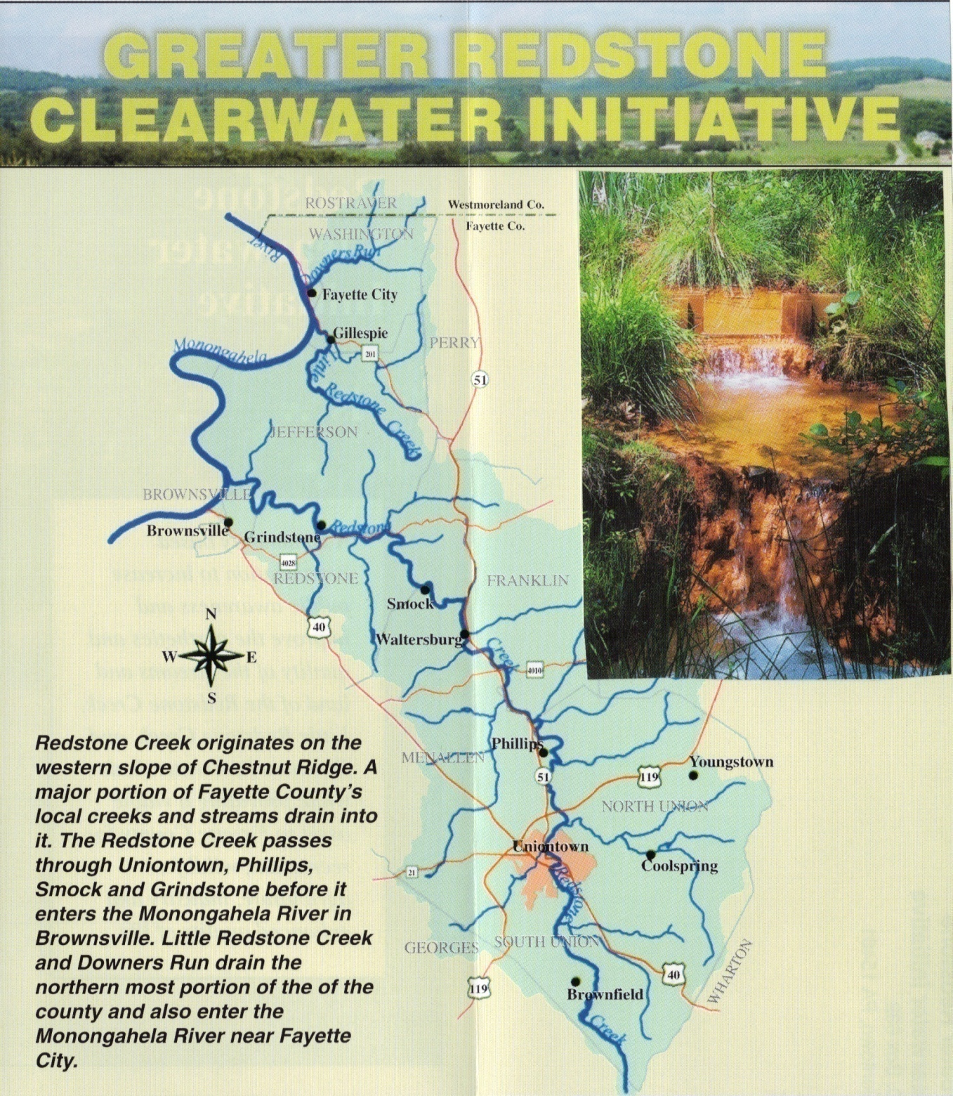

Slide 20


Slide 21

TEACHER WORKSHOPS

Slide 22
QUESTIONS
?

